Slide 1








HSE GOOD PRACTICES & INITIATIVES
A Portfolio of Safety Culture and Compliance

Slide 2
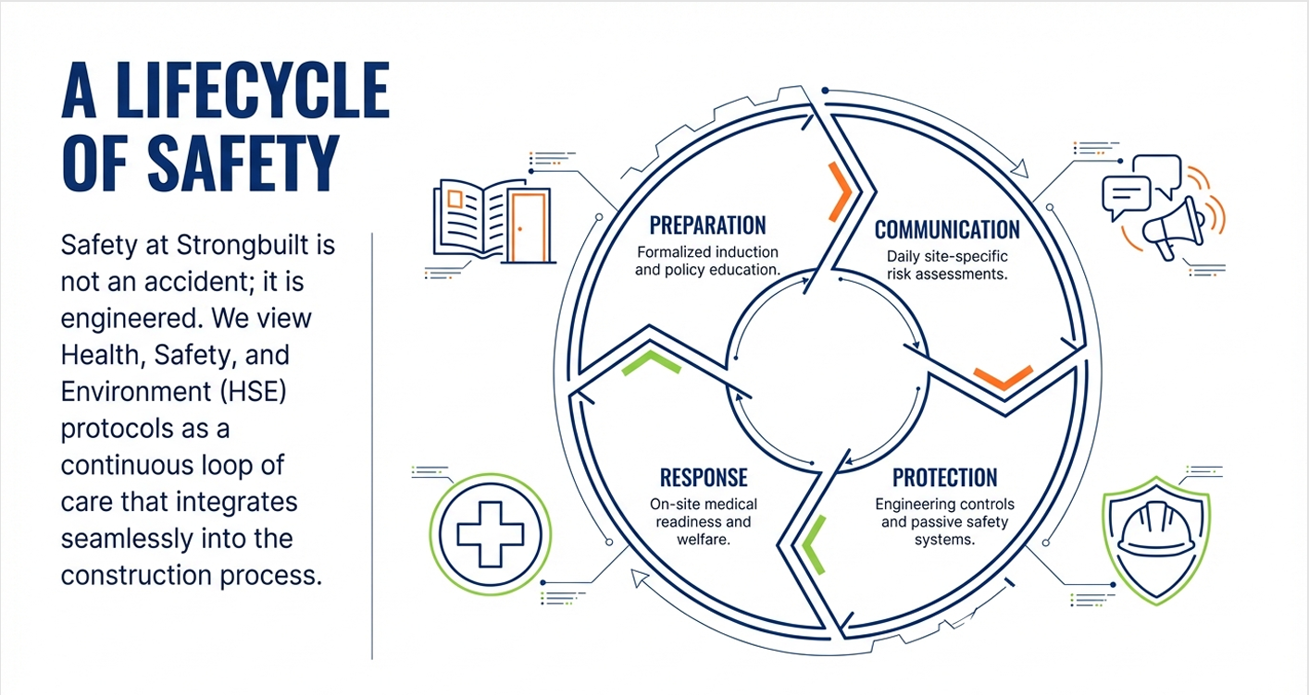

Slide 3
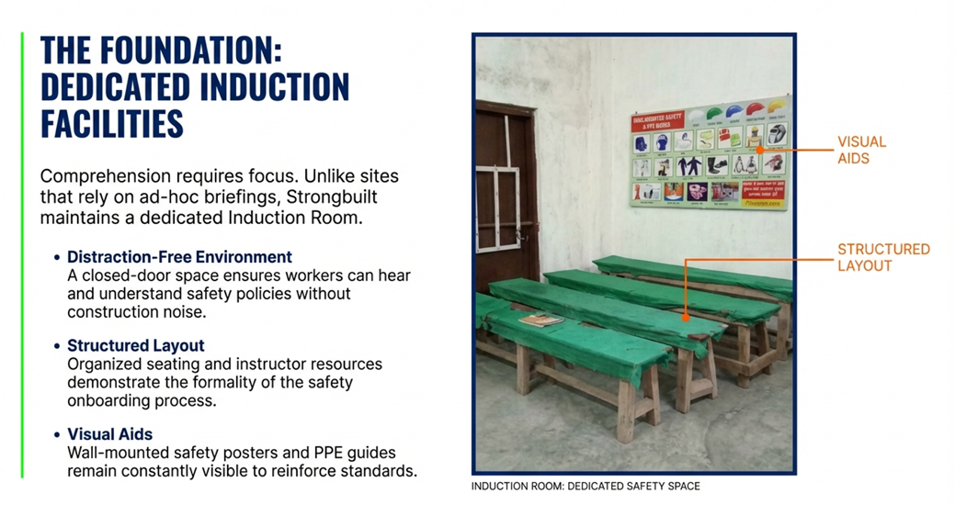

Slide 4
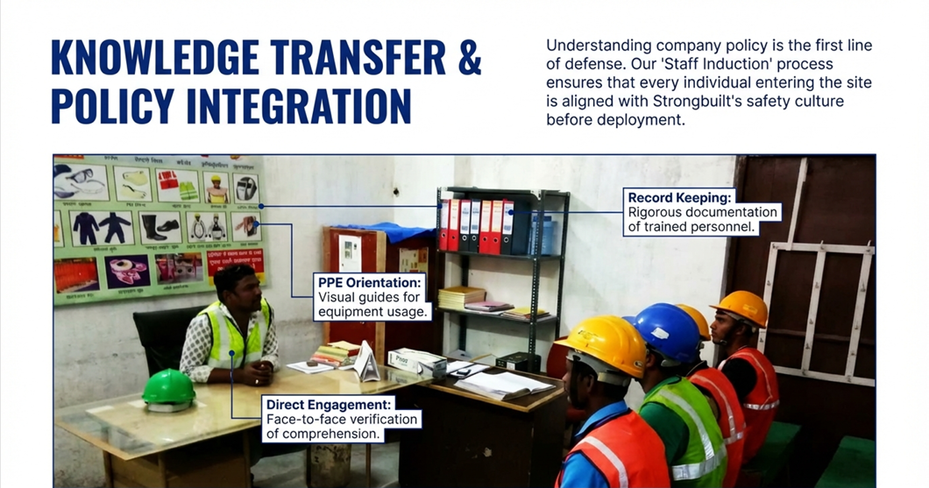

Slide 5
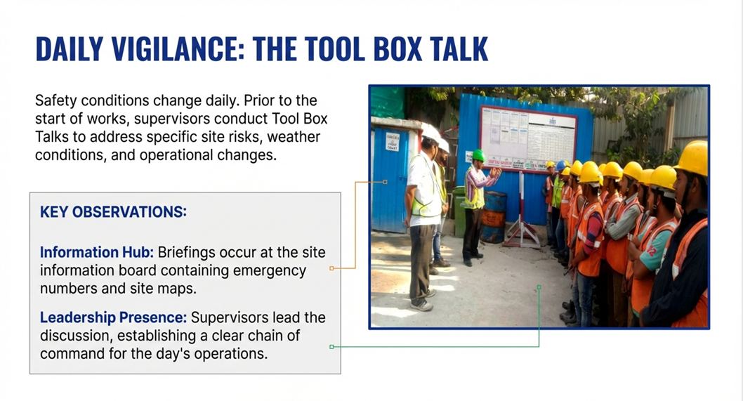

Slide 6
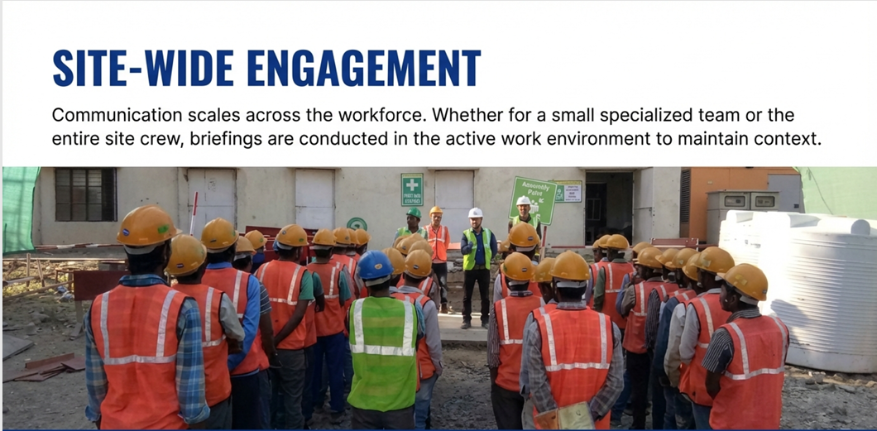

Slide 7
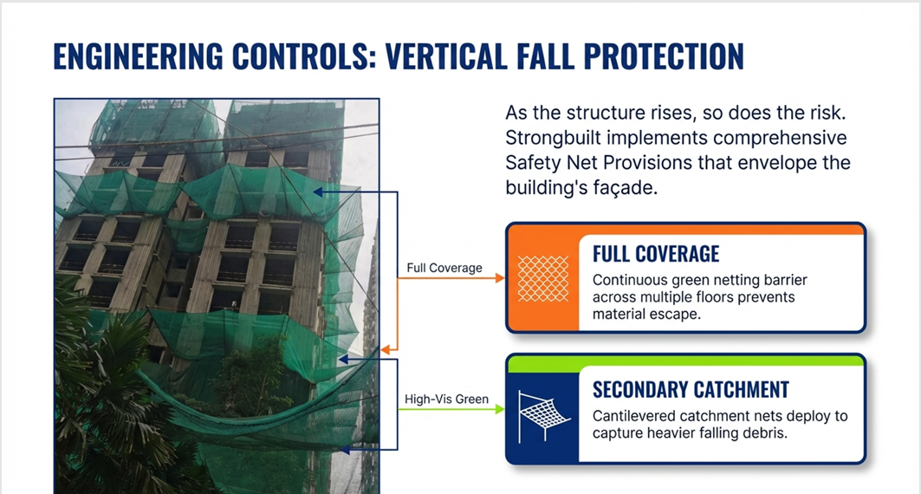

Slide 8
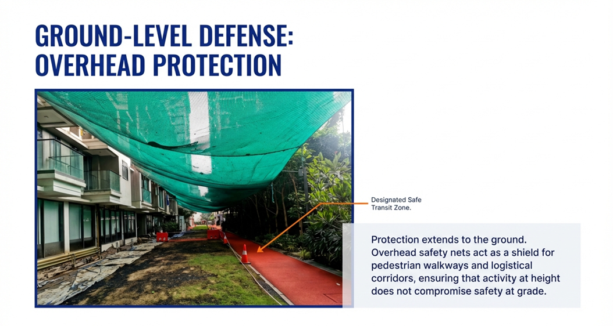
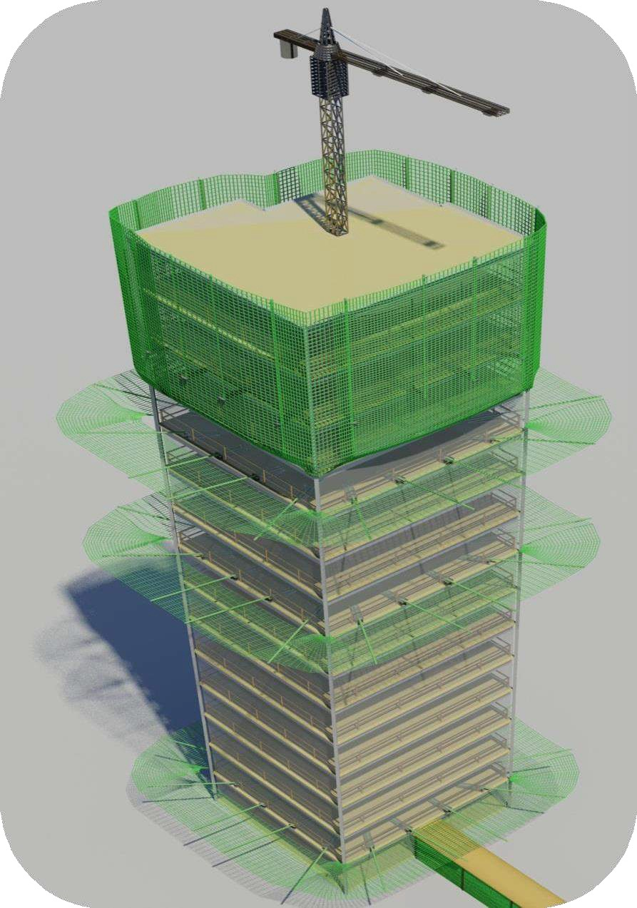

Slide 9
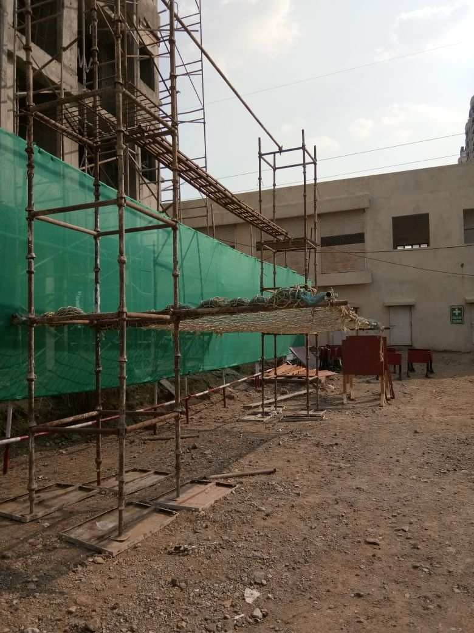
Arrangement for Height Phobia tests as preventive measures against accidents.
Preventive medical screening to identify workers unfit for elevated work environments
Medical Parameters like BP, Pulse, SpO2 monitored before and after test

Slide 10
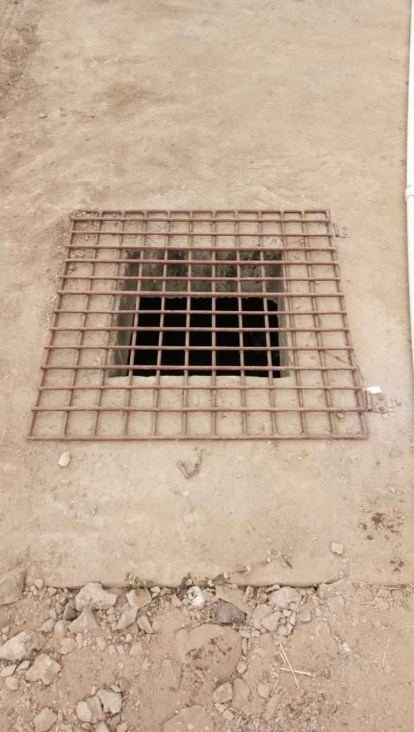
PROTECTION AGAINST FALLING IN SEPTIC/WATER TANKS
COVERS
Secure covers for floor holes that prevent from falling in the septic tanks along with making the workers aware of all the tank locations.

Slide 11
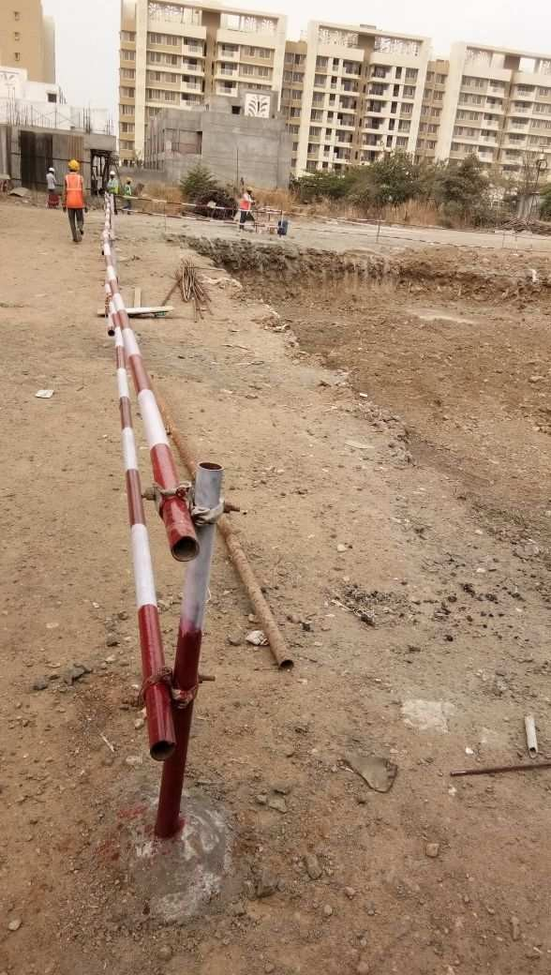
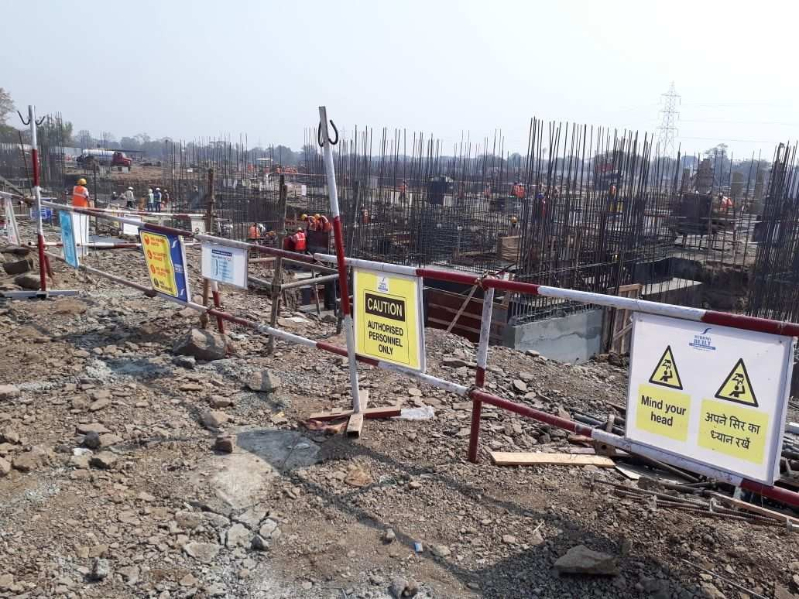
PROVISION OF HARD BARRICATION IN DEEP EXCAVATION/WORKING AREAS
Placement of Guardrails around the boundary of all deep excavation and working areas along with high visibility warning signs.

Slide 12
SITE SAFETY PARK
Hands-On Training
Hazard Recognition
Emergency Drills
Practical demonstrations of proper PPE usage, equipment handling, and emergency procedures in controlled environment.
Simulated hazard scenarios help workers identify risks, understand consequences, and develop proactive safety mindset.
Regular practice of evacuation procedures, first aid response, and crisis management builds confidence and readiness
Interactive Learning
Risk Awareness
Preparedness

Slide 13
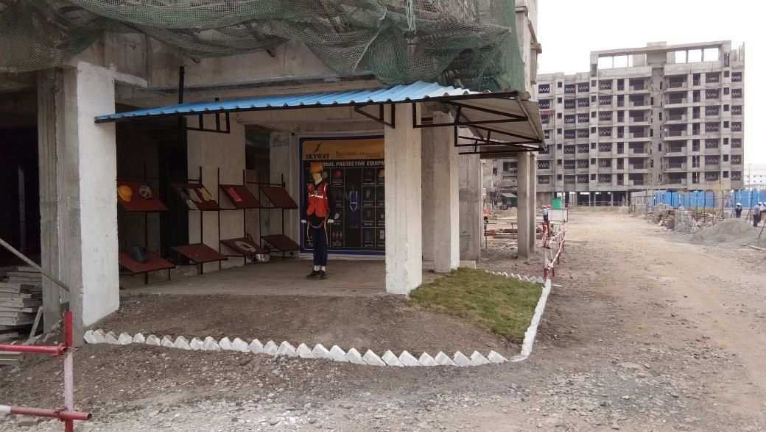

Slide 14
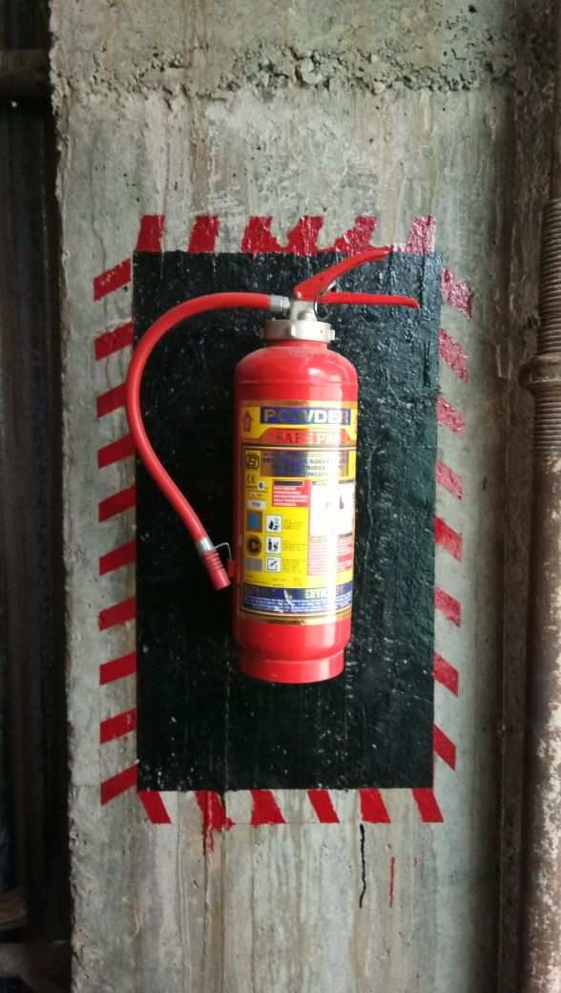
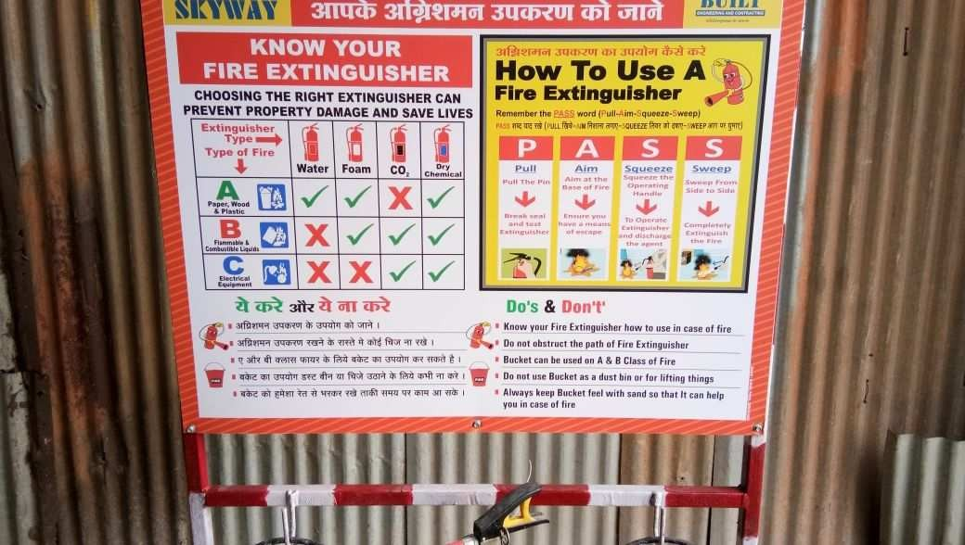
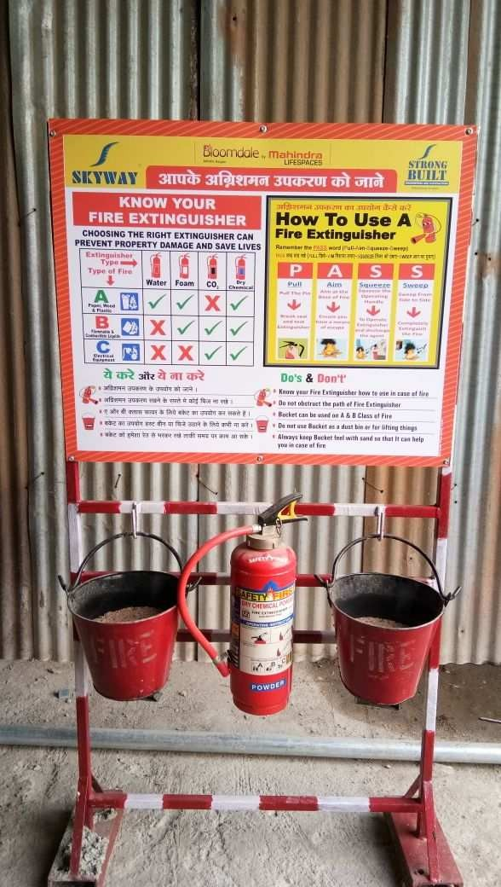
FIRE EXTINGUISHER AND
EXTINGUISHING PROCEEDURE
PASS Technique
Fire Extinguisher
P
A
S
S
Strategic placement within 100 ft of fire hazards along with weekly visual inspection.
Pull
Aim
Squeeze
Sweep
the pin
at base
the handle
side to side

Slide 15
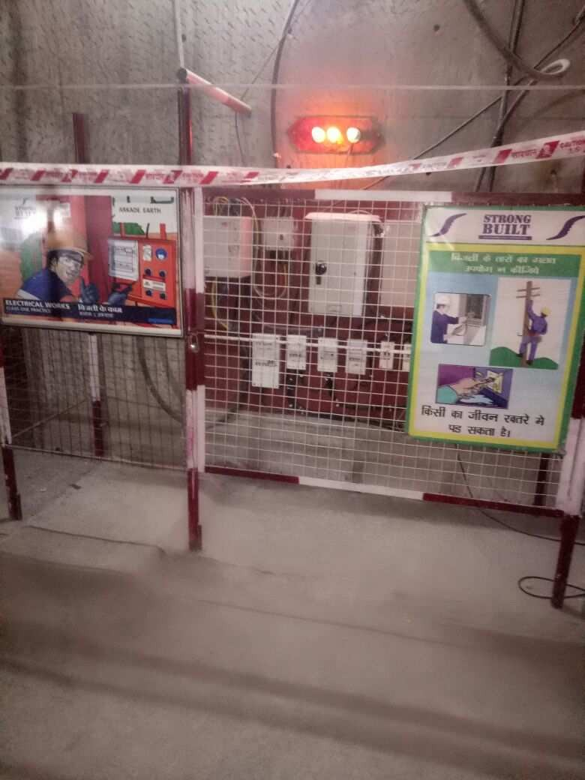
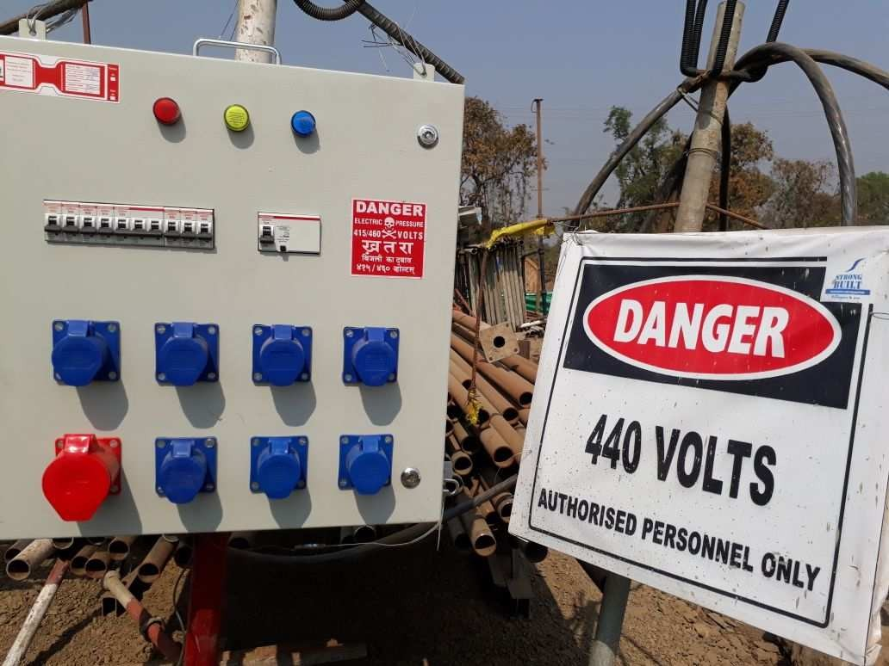
STANDARD PROCEDURES FOR ELECTRICALSAFETY
BEING FOLLOWED TO PREVENT HAZARDS
Qualified Personnel
Proper Grounding
Only trained and authorized workers perform electrical tasks. Competency verification required.
All equipment must be properly grounded. Regular testing of ground connections ensures safety.
Visual Inspection
Monthly Tagging System
Check for damaged cords, cracked plugs, burn marks, loose parts
Comprehensive electrical testing and tagging system ensuring all equipment is safe for use

Slide 16
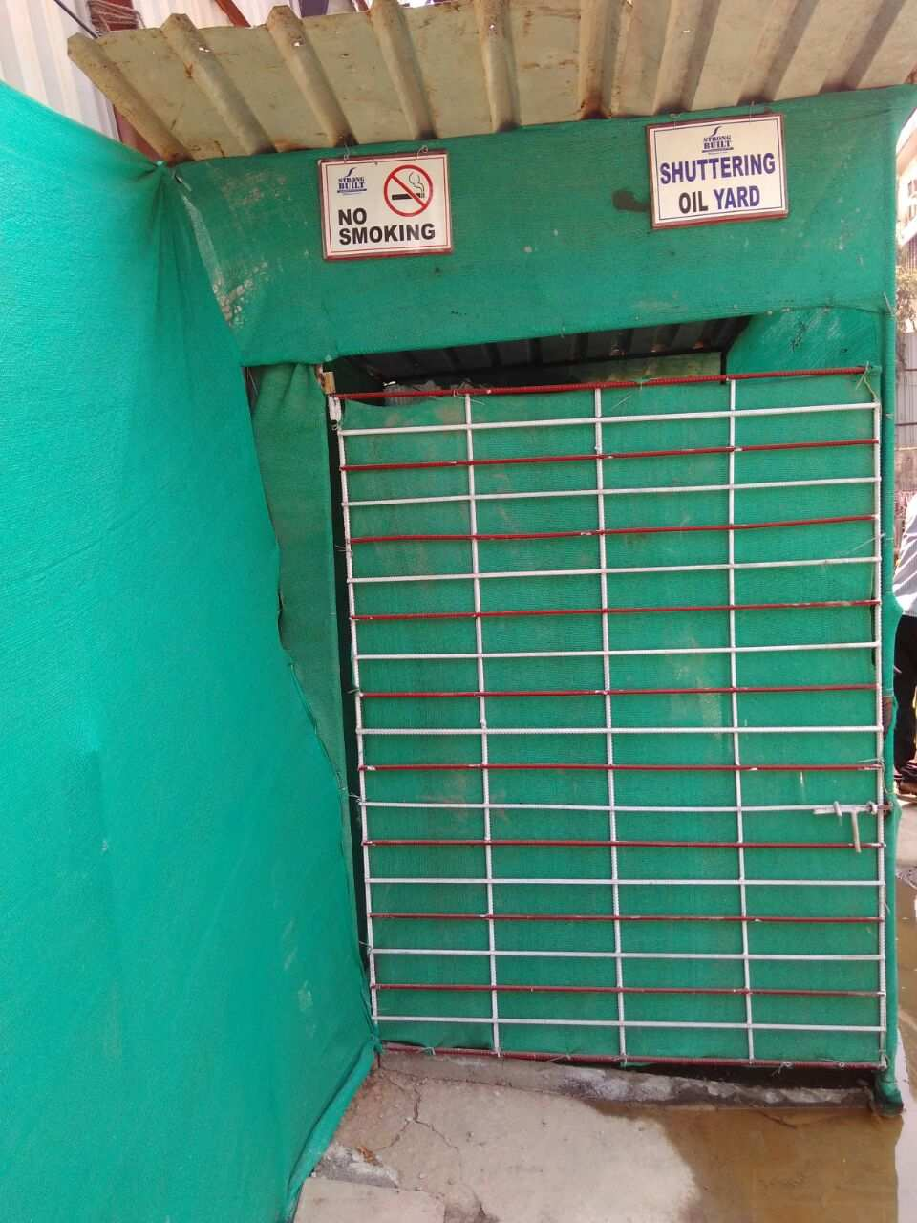
CHEMICAL STORAGE YARD SAFETY
Comprehensive safety measures for hazardous materials storage ensuring worker protection
SEGREGATION
Incompatible chemicals stored separately
LABELING
Clear hazard symbols and handling instructions
ACCESS CONTROL
Authorized personnel only with PPE
EMERGENCY PLAN
Spill response and evacuation procedures

Slide 17
